Slide 1


Oral Communication Skills A
(CELEN069)
Lesson 9.2

Slide 2
Lesson aims and objectives
By the end of this lesson, you should have enhanced your speaking and listening ability through practice.
In addition, you should be better able to … | Intended Learning Outcomes
divide a discussion task into appropriate stages | 1.1-1.3 1.6 2.3 2.5
produce effective notes for a discussion task

Slide 3

Getting started

Slide 4

Getting started
For homework you watched a video (1-4) related to the future of shopping. You made notes to answer a focus question for your video.
Different areas of the room will be given a number 1-4. Go to the area with the same number as the video you watched. Discuss the focus question with others in the same area.
Focus questions:
Area 1: How can data be used to make shopping in stores more convenient in the future?
Area 2: In what ways is Alibaba leading innovation in supermarkets and fashion retail?
Area 3: How will shopping in the fashion industry change in the future?
Area 4: Why has live streaming been so successful, and what is the future of livestreaming?
At the end of the activity, sit in a group with students who watched the other videos.

Slide 5

Language and skills focus
(Organising the task)

Slide 6
Language and skills focus: Organising the task
During your Group Discussion Exam, it is important that you complete the task, giving sufficient time for each stage. This is everyone’s responsibility.
The ability to break down a task into stages in order to achieve a specific goal is an important soft skill in academia, the workplace and life in general.
In your group, answer the following questions related to the Group Discussion Exam:
What is the task goal?
What are the stages?
What do you think you should be doing at each stage?
How long do you think you should spend on each stage?

Slide 7
Language and skills focus:
Language and skills focus: Organising the task
Answers:
What is the task goal?
Brainstorm 2-3 items and then rank them according to the criteria provided.
What are the stages?
Opening the discussion → Gathering ideas → Ranking → Conclusion
What do you think you should be doing at each stage?
Opening the discussion: Making sure everybody understands the task - paraphrasing the
question, narrowing the focus / defining any key terms (if necessary).
Gathering ideas: Introducing ideas and developing/ discussing others’ ideas. Providing explanations, evidence and examples. Reaching a consensus of the 2-3 agreed items.
Ranking: Comparing & contrasting, discussing opinions about the ranking order, reaching a consensus of the ranking order.
Conclusion: Summarising the discussion.

Slide 8
Language and skills focus: Organising the task
Answers:
How long do you think you should spend on each stage?
Suggested rough timings (9/12 minute discussion):
Opening the discussion: 1 minute
Gathering ideas: 5/7 minutes
Ranking: 2/3 minutes
Conclusion: 1 minute
A countdown timer will be visible for the preparation time and discussion during the exam.

Slide 9
Language and skills focus
(the 2min preparation time)

Slide 10
Language and skills focus: Preparation time
In the Group Discussion Exam, you will have 2 mins preparation time.
It is up to you how you spend your preparation time, but one possible idea is to work individually at the start, then spend the final 20-30 seconds communicating with each other as a group.
Ways to usefully use the 2 minutes of preparation time:
Individually | As a group
Identify any words/ terms in the prompt that need definition/ explanation or may need to be narrowed down. Brainstorm ideas for the topic. Note any examples, evidence or further ideas. Try to organise your notes on the paper so that you can refer to them easily during the discussion. | Note each other’s names. Decide who will start the discussion. You can talk to the other group members IN ENGLISH. You could receive a penalty for speaking in another language in the 2 mins preparation time.

Slide 11
Language and skills focus: Preparation time
What tech? All?
Health: Mental? Physical?
Social media
Lack of human contact (mobile phone/ mental health lecture)
Wasting time → stress (e.g. studying- Impact of SM lecture)
Gaming and TV
Less physical exercise
Screen time= eye damage (self-study reading article)
Food delivery
Convenient- no effort (e.g. Dianping)
unhealthy food
John, Michaela, Robert
It is important to make clear notes during the preparation time. You should not waste time during the discussion trying to understand your notes.
Points that may need clarifying about the prompt (if any)
Ideas organised with underlined headings and bullet points
Notes of evidence/ examples
Other group members’ names
Agree on 2-3 ways in which technology negatively affects human health.
Rank them starting with the greatest impact.

Slide 12

Discussion focus

Slide 13
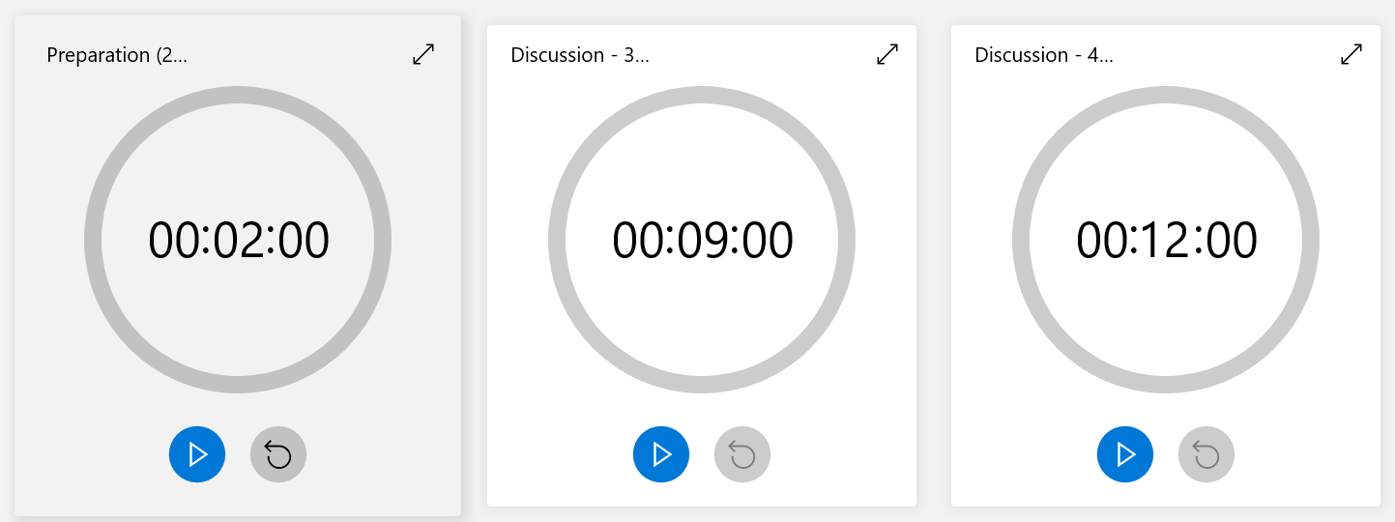
Discussion focus: Timed practice
You will now be given 2 minutes preparation time. Use a blank piece of paper to make notes.
Then, you will complete the group discussion
(9 min for 3 students / 12 min for 4 students).
Make sure you pay attention to the timers on the projector screen.
Agree on 2-3 ways that technology will affect shopping in the future.
Rank them starting with the greatest impact.
Notes:
https://www.timeanddate.com/timer/

Slide 14
Discussion focus: Reflect
Reflect on your group discussion and answer the questions below.
 |  | Yes | Partly | No
My group | Opening the discussion: We made sure that everyone understood the topic.
 | Gathering ideas: We introduced and developed our ideas.
 | Ranking: We justified our choices for the ranking.
 | Conclusion: We summarised our discussion.
Me | I made effective notes during the 2 mins preparation time.
 | I used my notes to help me express my ideas.
 | I contributed to each stage of the task.
1 or 2 things I did well…
1 or 2 things I could do better in the next discussion…

Slide 15
Homework
Due | Task
Lesson 10.1 | Watch Lecture 5B: Technology and sedentary lifestyles and take notes. ​You will use these notes later when you revise for the Group Discussion Exam.
 | Watch the YouTube video ‘Meet the AI robot capable of human emotions’ and complete the Getting started activity in the Class Workbook (Lesson 10.1).​ You can find the link to the video on the OCSa Moodle page, in the Week 10 section. N.B. You should be connected to eduroam wifi to watch the video. ​ Complete ‘Vocabulary building’ tasks A & B (Class Workbook - Lesson 10.1 ).​

Slide 16

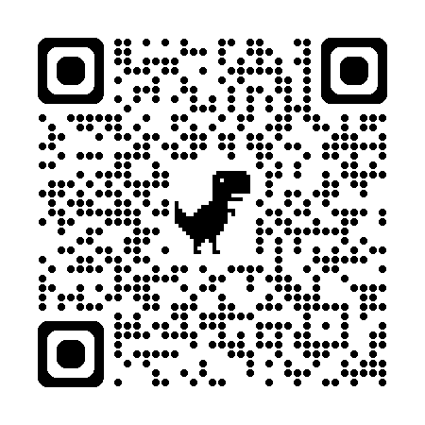

Week 9
Extra resources for OCSa this week on the Writing Lab Moodle page:
Speaking → University speaking tasks (group discussions)
Next week (Week 9 – beginning the 2nd of December):
Utalk continues! Monday → Friday PB 115.
Evening sessions available (check SPDPO system for times)
NEW!
Extra group discussion practice (with feedback)
Sign up via the Writing Lab Friday email.
Centre for English Language Education CELE N048 AY 24-25

